Slide 1

*
Chapter Thirteen
Marketing: Helping Buyers Buy
Speaker:
Tania Akter (TAK)
*
McGraw-Hill/Irwin
Copyright © 2010 by The McGraw-Hill Companies, Inc. All rights reserved.

Slide 2
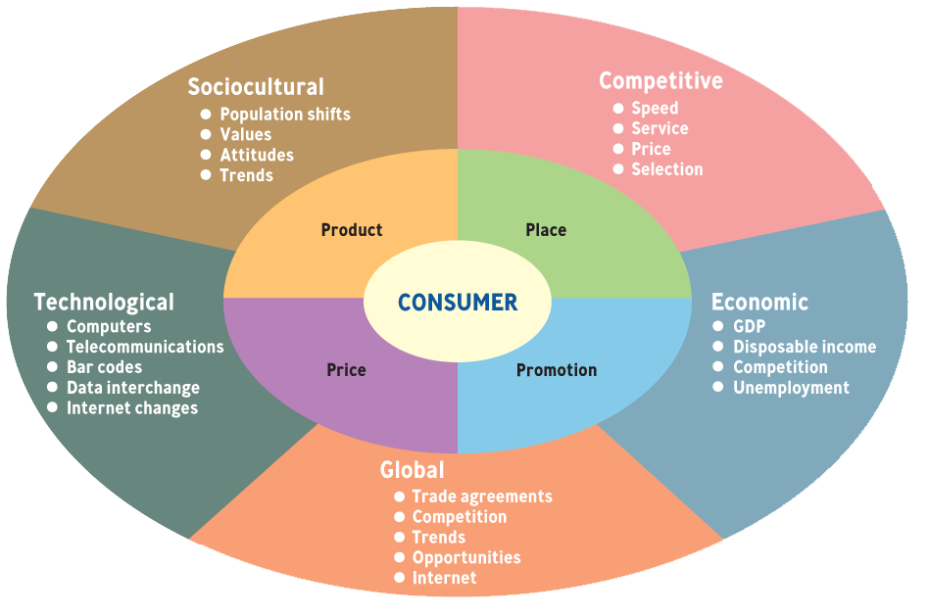
The MARKETING ENVIRONMENT
*
The Marketing Environment
The Marketing Environment
*
LG4
13-<number>

Slide 3

The Marketing Environment
Marketing managers must be aware of the surrounding environment when making marketing mix decisions. Environmental scanning is the process of identifying factors that can affect marketing success
Global Factors
Using the Internet, businesses can reach many of the world's consumers relatively easily and carry on a dialogue with them about the goods and services they want.
The globalization process puts more pressure on those whose responsibility it is to deliver products. Many marketers outsource delivery to companies Iike FedEx, UPS, and DHL, which have a solid reputation for shipping goods quickly.

Slide 4

Technological Factors
The most important technological changes also relate to the Internet. Using consumer databases, blogs, social networking, and the like, companies can develop products and services that closely match consumers’ needs. You can
imagine, for example, using databases to help you devise custom-made ftuit mixes and various salads for your customers at Very Vegetarian.

Slide 5


Sociocultural Factors
Marketers must monitor social trends to maintain their close relationship with customers, since population growth and changing demographics can have an effect on sales.
The increase in the number of older adults creates growing demand for nursing homes, health care, prescription drrrgs, recreation, continuing education, and more.other shifts in the u.S. population are creating new challenges for marketers
as they adjust their products to meet the tastes and preferences of Hispanic, Asian, and other growing ethnic groups.

Slide 6

Competitive Factors
of course, marketers must pay attention to the dynamic competitive environment.
Many brick-and-mortar companies must be aware of new competition from the Internet, including firms that sell automobiles, insurance, music,and clothes. In the book business, Barnes & Noble and Borders Books are still adjusting to the new reality of Amazon.com's huge selection of books at good prices. Now that consumers can literally search the world for the best buys through the Internet, marketers must adjust their pricing, delivery and service accordingly.

Slide 7
Economic Factors
Marketers must pay close attention to the economic environment. As we began the new millennium, the United States was experiencing unparalleled growth, and customers were eager to buy even the most expensive automobiles, watches, and vacations. But as the economy slowed, marketers had to adapt by offering products that were less expensive and more tailored to consumers with modest incomes.
Bangladesh has made remarkable progress in reducing poverty, supported by sustained economic growth. In parallel, life expectancy, literacy rates and per capita food production have increased significantly. Progress was underpinned by steady growth in GDP, which averaged 6.5 percent in the last decade (according to official estimates). Rapid growth enabled Bangladesh to reach the lower middle-income country status in 2015. In 2018, Bangladesh fulfilled all three eligibility criteria for graduation from the UN’s Least Developed countries (LDC) list for the first time and is on track for graduation in 2024.
Source: https://www.worldbank.org/en/country/bangladesh/overview

Slide 8
Now watch this example of marketing environment and give your comment in the following site!
https://go.parlayideas.com/classes/ff76fd3e-528c-4685-ace6-2addae6d3ab6/roundtables/online/e5867eda-3c20-41fb-9376-163548d9ebef/

